Slide 1

Guide : Ms.Nalini Sampath
Team : Kamma Rakesh - (BL.EN.U4CSE17054)
Kollipara Bala Vineel - (BL.EN.U4CSE17062)
Korupolu Nitya - (BL.EN.U4CSE17063)
REAL-TIME COMPUTER VISION USING CNN FOR MULTI-LABEL FRUITS CLASSIFICATION

Slide 2
Problem Domain -
Computer Vision,CNN
Problem Definition -
To design a fruit grading system using single shot detectors(YOLOV3) with fruitsgb indian dataset.

Slide 3
Justification for the proposed problem
Motivation and Need:
Automation in food processing comes into play to increase productivity, quality and profitable growth of the country.
Fruit grading is an important process for producers which affects the fruits quality evaluation and export market. Although the grading and sorting can be done by the human, but it is slow, labour intensive and tedious. Hence, there is a need of an intelligent fruit grading system.
It would be helpful for many industries to predict whether a fruit is good or bad in-terms of quality by using fruit grading system.

Slide 4
Software/Hardware Requirements
Python
Numpy,CV2 libraries
Google collab(jupyterlab)
Labellimg-Used to label the dataset.
CPU: Intel Core i5 2.6GHz or higher.
RAM: 16GB or higher.
Graphics Card: NVIDIA GeForce GT 760 (2GB) or higher/equivalent AMD graphics card.
O/S: Windows 8 64-bit (The system is unavailable for 32-bit)

Slide 5
Literature Survey
S.NO | Author(s) | Title of the paper | Inference from the paper | Findings
1. | Bresilla Kushtrim, Perulli Giulio Demetrio, Boini Alexandra, Morandi Brunella, Corelli Grappadelli Luca, Manfrini Luigi. | Single-Shot Convolution Neural Networks for Real-Time Fruit Detection Within the Tree (2019) | Using its architecture- single shot detectors(YOLO) because it works better when there is less amount of data. for suppose, 12,000 images | Single shot detectors (YOLO) as a CNN to detect fruits of apple and pears in the tree

Slide 6
2. | santi kumari Behera, Amiya kumar rath, Abhijeet Mahapatra, Prabira kumar sethy | Identification, classification & grading of fruits using machine learning & computer intelligence. (2020) | We used the metrics that are used mostly in this articles (Mean Average Precision) | This paper presents a brief analysis of techniques proposed in the research articles in the year 2010 to 2019, with a focus on the development of state of the art.

Slide 7
3. | Shaohua Wan,Sotirios Goudos | Faster R-CNN for multi-class fruit detection using a robotic vision system(2019) | Considering the best detection results,we are using YOLOV3 for our model. | The paper has checked the calculation performance of 6 algorithms namely YOLO, FAST R-CNN, Faster R-CNN, YOLOv2, YOLOv3 and Improved Faster R-CNN and has observed that YOLOv2, YOLOv3, and the proposed improved Faster R-CNN algorithms have the best detection results.

Slide 8
4. | Jan Steinbrene,Konstantin Posch,Raimund Leitner | Hyperspectral fruit and vegetable classification using convolutional neural networks (2020) | We took the dataset(fruitsgb) from yhis paper. | In this study, we present an easy and effective way to classify smaller data sets of hyperspectral images of fruits and vegetables with standard, large convolutional neural networks optimized for RGB image data.

Slide 9
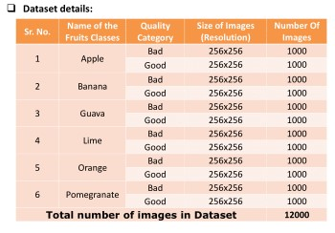
Details of Dataset

Slide 10
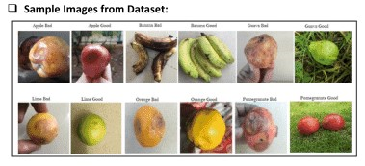
1.a) Apple bad 1.b) Apple good
2.a) Banana bad 2.b) Banana good
3.a) Guava bad 3.b) Guava good
4.a) Lime bad 4.b) Lime good
5.a) Orange bad 5.b) Orange good
6.a) Pomegranate bad 6.b) Pomegranate good

Slide 11
Implementation Details
Loading and compiling the Architecture
Custom Labelling the dataset
Downloading pre defined weights from darknet53.conv.74
Training,validating and testing on dataset
Python program implementation for detecting fruits

Slide 12
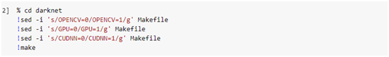
Here we are downloading the darknet file from github.
Enabling opencv - To use while training images and making predictions.
Enabling gpu - To increase speed of training that uses cnn.
Enabling Cudnn - The Nvidia Cuda Deep Neural Network library.

Slide 13
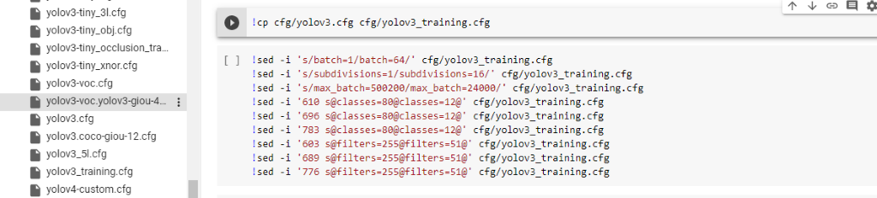
Here we are setting up yolo architecture by setting
Batches to 64
Subdivisions to 16
No of classes=12
Max batch=(no of classes * 2000) =24000
Filters=(no of classes +5)*3 =51

Slide 14
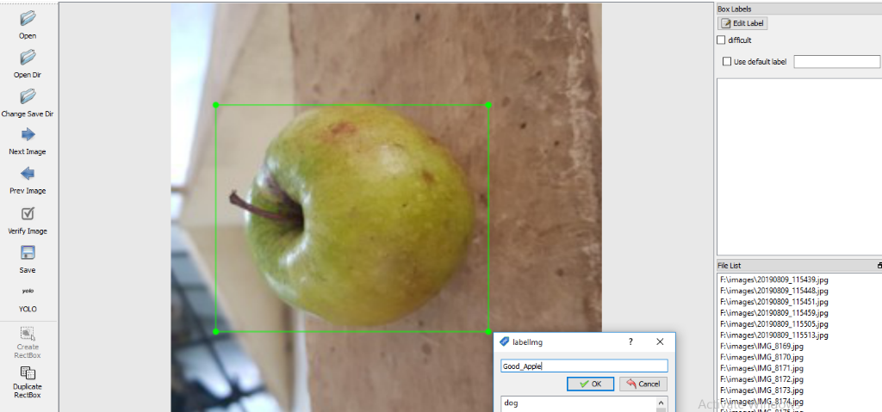
Here by using ( labellimg ) we are custom labelling our dataset.

Slide 15
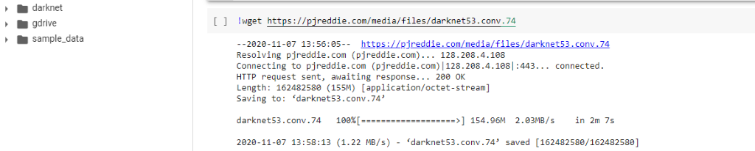
Downloading the pre-defined weights which are in darknet53.conv.74 which are used to train the data

Slide 16
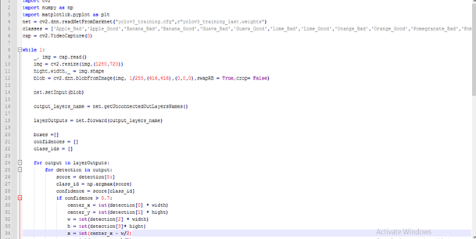
Here we use the updated weights from training ,class names and architecture files.
Here we can classify images and videos in real time.

Slide 17
Classification And Results
Finally we will apply machine learning algorithms on the processed data and find the accuracy of our model.These are the following results
Graph
Training
Testing
Validating

Slide 18
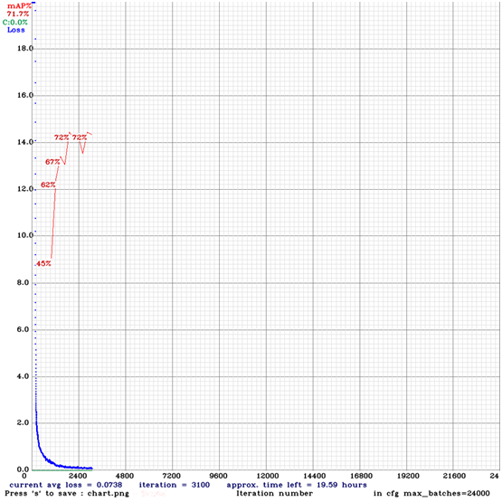
Graph for model using map(Mean average precision) as metrics

Slide 19
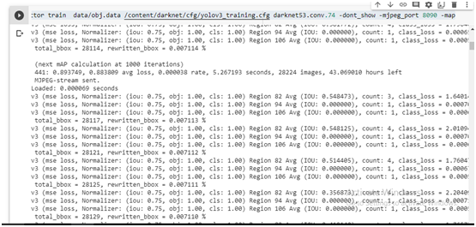
Training the data which is in obj.data using yolov3_training.cfg architecture and pre defined weights which are in darknet53.conv.74

Slide 20
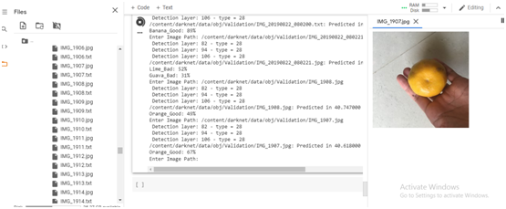
This is a sample screen shot which shows us how an orange is been tested
And after the testing process is done it gives us the result saying it is a good orange

Slide 21
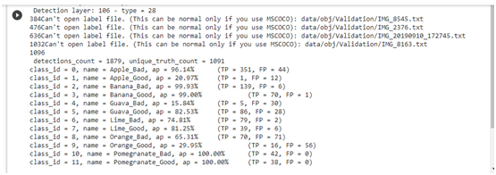
This is a sample screenshot of our Validation process.
Here each and every fruit contains an unique class_id,which helps the sytem to make the validation process faster

Slide 22
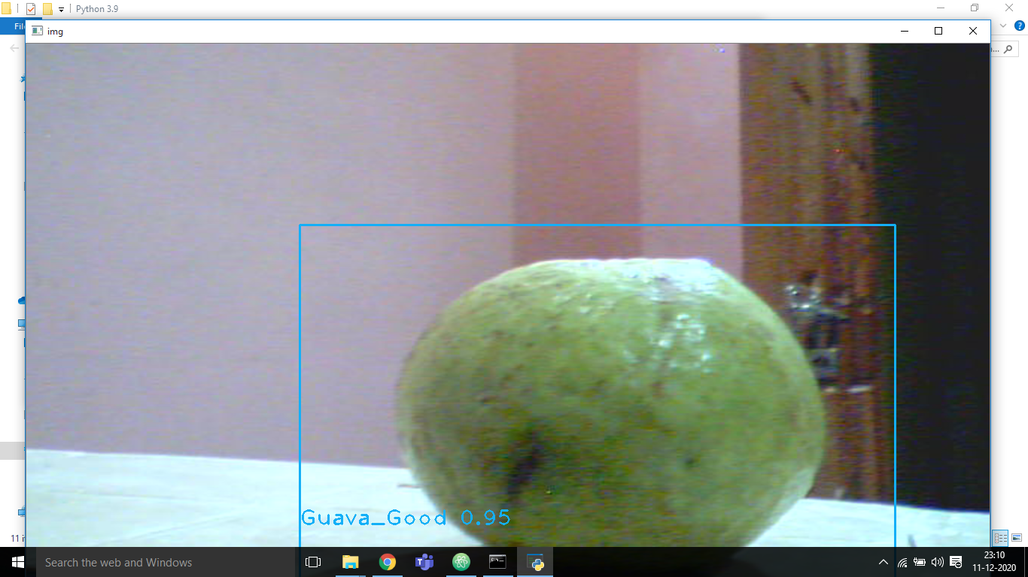
Obtained result from detecting real time fruit using Trained weights

Slide 23
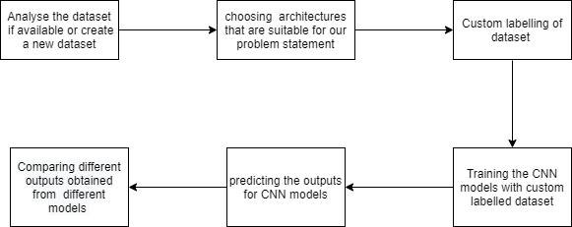
Work Flow Diagram

Slide 24
Timeline Chart
September-Mid October
Identification of problem domain,problem definition and literature survey,review
Mid November,today
partial review
End October
Architecture diagram,Setting up architecture,implementing code and testing
Mid December Complete Project implementation,Report and documentation

Slide 25
Conclusion:
Here we built a model on custom Fruitsgb dataset using yolov3 architecture ,Which will be used in real time fruit detection .
The main reason why we used YOLOV3 architecture is from previous research papers we understand that Yolov3 is more accurate and precise.
Here we obtained an mean average precision of nearly 72%
Yolov3 architecture is more flexible for this real time fruit detection project when compared with other architectures.

Slide 26
Future Scope
Making a software out of this to implement this methodology in real Time industries to grade the fruits automatically
Making an app that is useful for blind people to know the fruit is good or bad condition
Here we only classified 12 fruits and only with a small dataset of 12000 images. Hence, we can extend this to many fruits with a large dataset to generalize well.

Slide 27
References
[1] Kang, H., & Chen, C. (2020). Fast implementation of real-time fruit detection in apple orchards using deep learning. Computers and Electronics in Agriculture, 168, [105108]. https://doi.org/10.1016/j.compag.2019.105108
[2] Koirala, A., Walsh, K.B., Wang, Z. et al. Deep learning for real-time fruit detection and orchard fruit load estimation: benchmarking of ‘MangoYOLO’. Precision Agric 20, 1107–1135 (2019). https://doi.org/10.1007/s11119-019-09642-0
[3] Bargoti, Suchet and J. Underwood. “Image Segmentation for Fruit Detection and Yield Estimation in Apple Orchards.” J. Field Robotics 34 (2017): 1039-1060.
[4]Dubey, S., & Jalal, A. (2015). Application of Image Processing in Fruit and Vegetable Analysis: A Review, Journal of Intelligent Systems, 24(4), 405-424. doi: https://doi.org/10.1515/jisys-2014-0079
[5]Kayaalp, K , Metlek, S . (2020). Classification of Robust and Rotten Apples by Deep Learning Algorithm . Sakarya University Journal of Computer and Information Sciences , 3 (2) , 112-120 . DOI: 10.35377/saucis.03.02.717452
[6]Mureșan, Horea & Oltean, Mihai. (2018). Fruit recognition from images using deep learning. Acta Universitatis Sapientiae, Informatica. 10. 26-42. 10.2478/ausi-2018-0002
[7]Sa I, Ge Z, Dayoub F, Upcroft B, Perez T, McCool C. DeepFruits: A Fruit Detection System Using Deep Neural Networks. Sensors (Basel). 2016;16(8):1222. Published 2016 Aug 3. doi:10.3390/s16081222

Slide 28
Thank you….

